Slide 1
Tools for improving land administration in transition economies in Europe
Helge Onsrud

Slide 2
Kartverket’s International Services
Projects in former Soviet Union republics and in former Yugoslavia since year 2000
Kartverket administers projects. Goods and services procured internationally from private sector
Only projects with funding from the Norwegian government;
Programs for former socialist countries in Europe
5 former Soviet republics
All former Yugoslav republics
EEA financial mechanism for EU member states
Turnover 3-4 million EUR per year
Mainly targeting solutions for public services to the emerging markets in newly privatised/restituted property
IT systems for real estate registers, orthophoto, large scale maps, GPS for land surveying, address registers

Slide 3
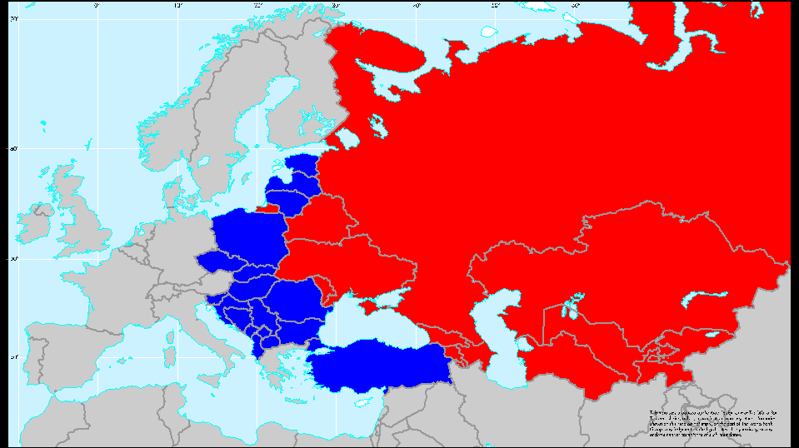
Largest number of properties ever registered in such short time - Europe and Central Asia (ECA) Region
Countries
30
Population
893,314,335
Land area (sq km)
27,381,299
Properties registered
Estimated at 300 million

Slide 4
Formalizing property rights
Privatization in former Soviet republics
Restitution of private ownership in other former socialist countries in Europe
Formalizing property rights largely completed throughout the region, but
Data quality remains a big issue
Discrepancies between legal information and maps
Ineffective structures in the agricultural sector
Unbuilt urban land and forest remain in state or municipal ownership
Largely satisfactory services to the land markets
Very sophisticated solutions in some countries
Taking up loans using property as collateral still at a comparably low level
Interests on loans coming down – a result of many factors

Slide 5
Doing Business (WB 2013) shows 11 of the top 30 countries for registering property are in ECA.
1 Georgia
3. Belarus
4. Armenia
5. Lithuania
8. Slovakia
9. Azerbaijan
11. Kyrgyzstan
14. Estonia
16. Moldova
27. Czech R.
28. Kazakhstan
Notes:
Out of 185 countries

Slide 6
However, the Balkans does less well (WB Doing Business 2013).
41. Serbia
50. Macedonia
61. Slovenia
68. Bulgaria
72. Romania
76. Kosovo
93. Bosnia & Herzegovina
104. Croatia
117. Montenegro
121. Albania
Notes:
Out of 185 countries

Slide 7
Restitution -privatization
Privatization in former Soviet republics
Restitution in other former socialist countries
Abolishing private ownership took different forms in different countries
Privatization and restitution largely completed
Done very quickly - major problems remain with data quality
Inefficient structures with agricultural land
Significant problems with multi apartment buildings
Lacking regulations for maintaining common parts
Lots of land remain in state or municipal ownership
Unbuilt land in urban areas, forest, …
However, services to the land markets very much improved
Very sophisticated technical solutions in some countries
Taking up loans using property as collateral still at a rather low level
Examples that interests on loans are becoming lower - result of many factors
Register data not guaranteed – trust in registers still an issue

Slide 8
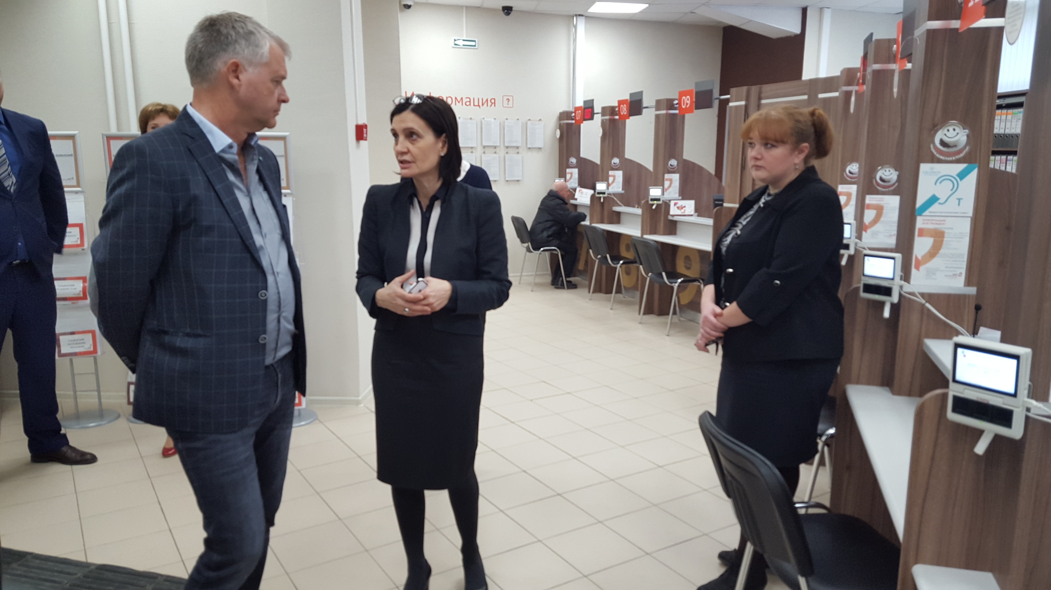

Slide 9
Key success factors
Technical tools for initial registration and for register systems generally not a big issue any more
Orthophoto, satellite data, standardized IT-systems, large scale maps, GPS
Technical tools have generally become much cheaper
Understanding “Fit for Purpose” in mapping properties
High resolution satellite images becoming relevant for real estate registration
Low cost GPS devices and tablets will substitute other methods for recording parcels boundaries
Countries with single institution for land register (legal information) and cadaster (property maps and technical information) do best

Slide 10
Key success factors
Build modular and centralised IT systems using SOA architecture and web services
Clarifying business processes up front critically important
IT systems should ideally be accompanied with legal and organizational reforms – but not too many reforms
Prepare large scale topographic maps for real estate registration
Servicing as well as many other usages
Topographic mapping has become very much cheaper
Combined with preparing orthophoto
however hitherto only done in few countries. Norway in Moldova, Georgia, Kyrgyzstan
Maintenance is critically important
Technical solutions and funding of maintenance should always be in place before mass registration of real estate. In parallel with preparing maps and investing in IT systems or in GPS/CORS systems
However, maintenance often neglected by countries and by donors

Slide 11
Key success factors
Use public – private partnership
Use local private companies when relevant and available
Competences for public procurement critically important - topic for foreign support
Combined contracts for establishing solutions and for subsequent operation and maintenance should be explored (ref Scotland LR)
Apply a holistic approach
Registers of citizens, businesses and addresses are also needed for functioning land markets
Norwegian initiative of owners of key public registers to join forces in foreign development aid supported by Norad’s knowledge bank ; "Registers for development”
Address solutions for conflict resolution – still a big potential for improvements
Address corruption

Slide 12
Key factors for success
Setting priorities right
Focus on effects to economic development – also geographically
General economic development also needed for fighting poverty, improving women rights etc
Underpin entrepreneurship and job making
Facilitate domestic and foreign investments
Prioritise urban areas and properties in buildings before rural areas?
Consider the capacity of public institutions in the land sector
Many institutions too ambitious in addressing other topics than supporting the land market
Foreign interventions should be better co-ordinated - donors competing for their share
Should real estate registration and services continue to belong to the mapping sector ?
Could mandatory use of notaries be abolished ?

Slide 13
It is doable
But depends heavily on;
Political will and support
Good managers of public institutions involved
Finally, it is doable ; The story of Armenia reforming land registration in one year
Removing bureaucratic barriers to registering transactions
Removing mandatory use of notaries
Stopped requiring a new survey of properties before transaction
Setting maximum handling times
Centralising registration, keeping remote client contact points
Addressing corruption

Slide 14
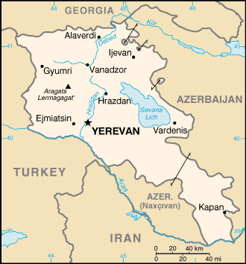
Armenia

Slide 15
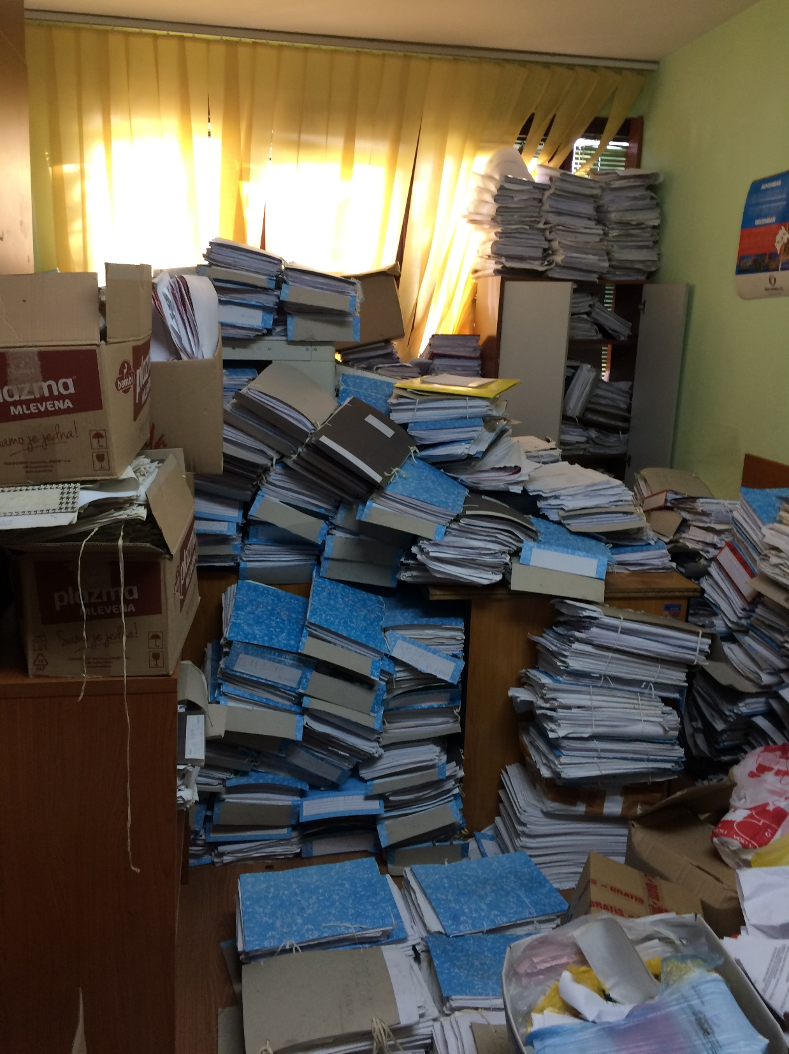

Slide 16
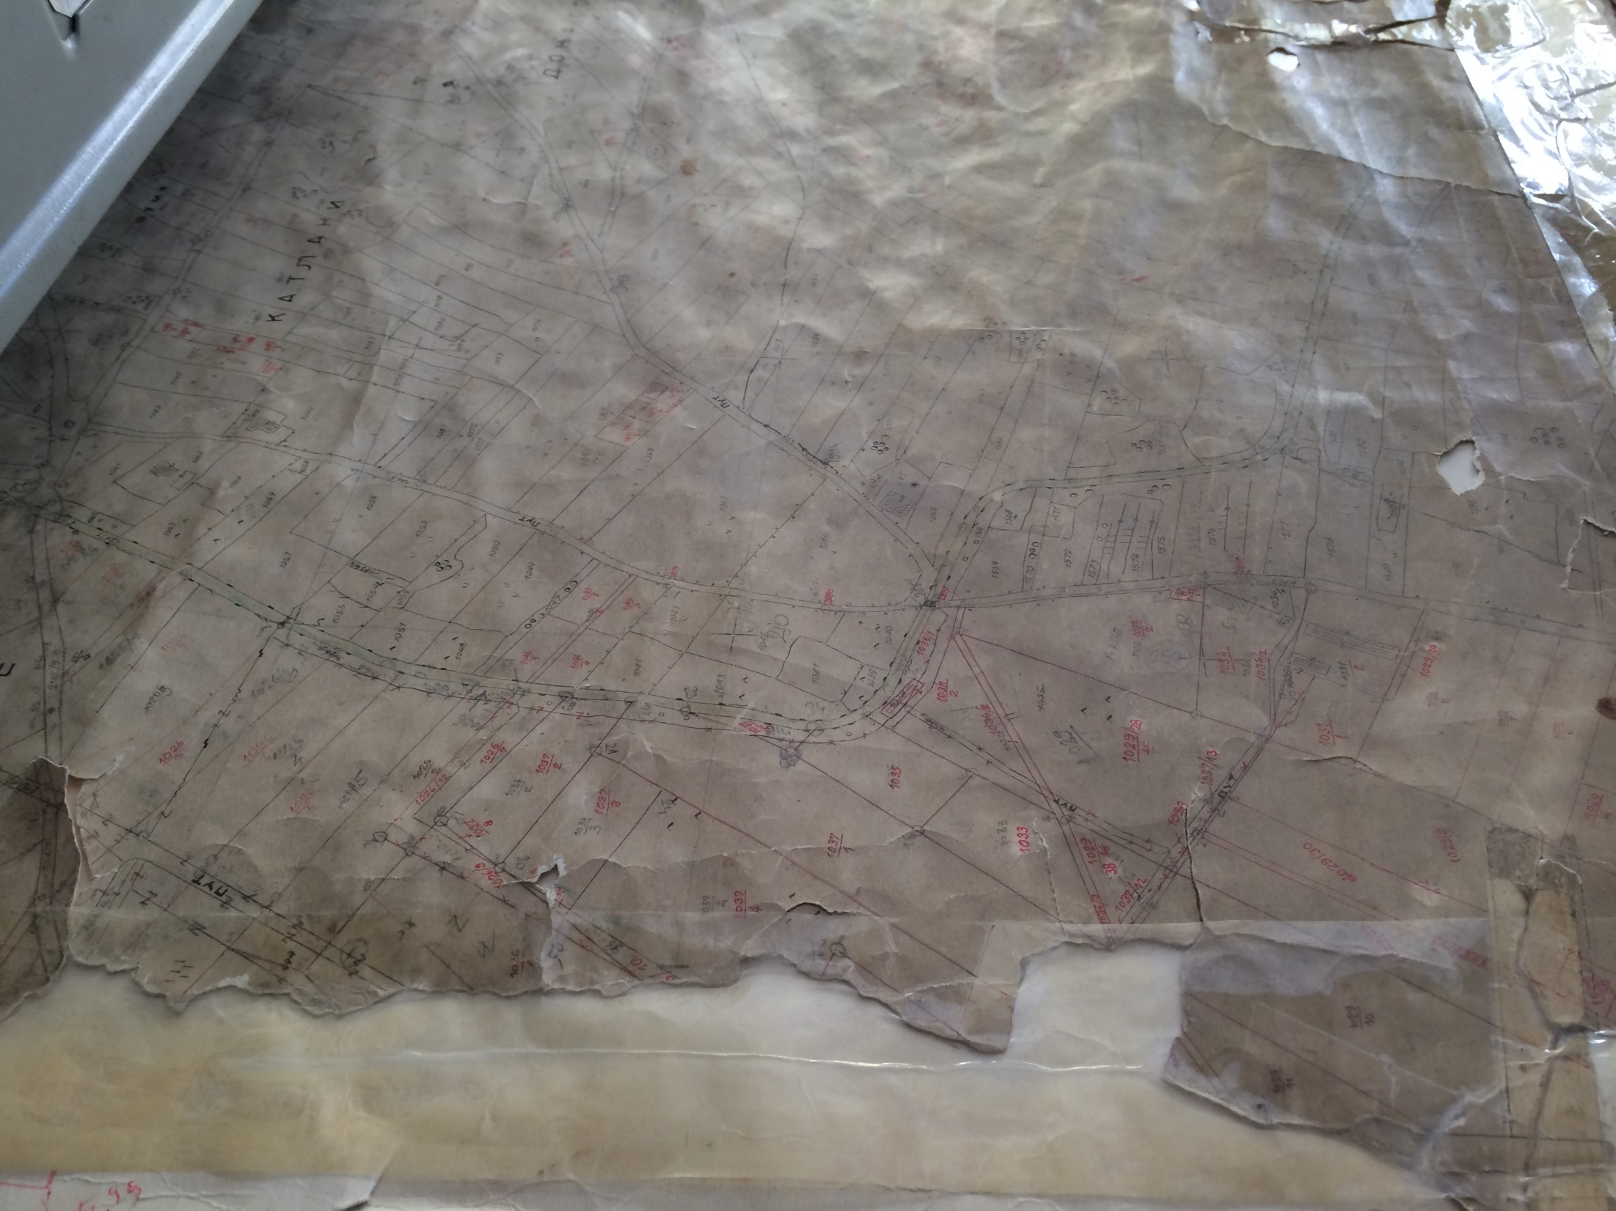

Slide 17
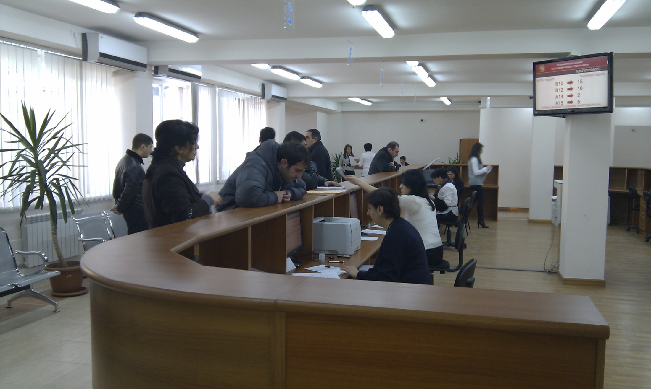
Yerevan Cadastre Office opened on 2. January 2012

Slide 18
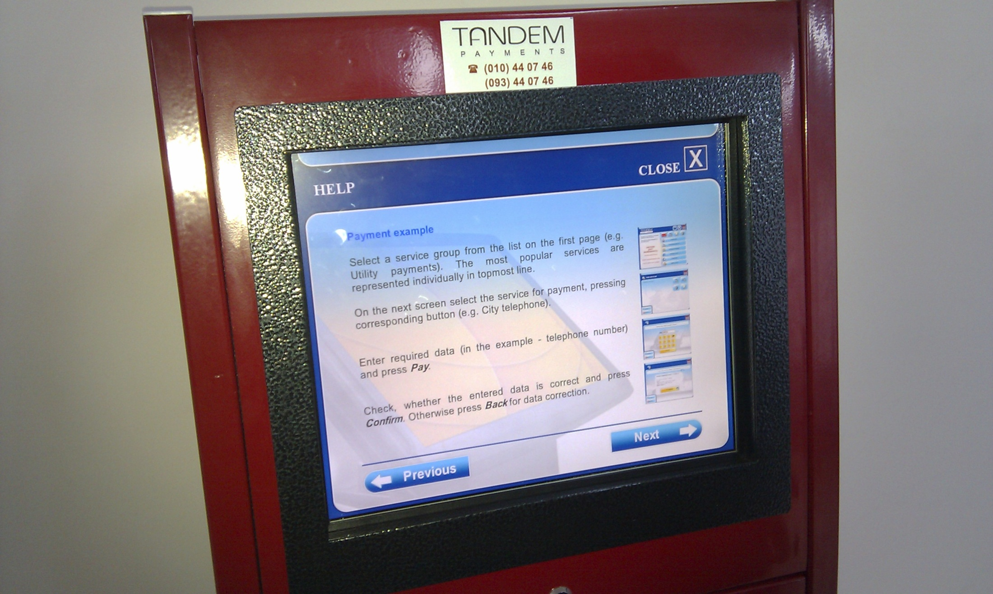
Find the information you need for your case

Slide 19
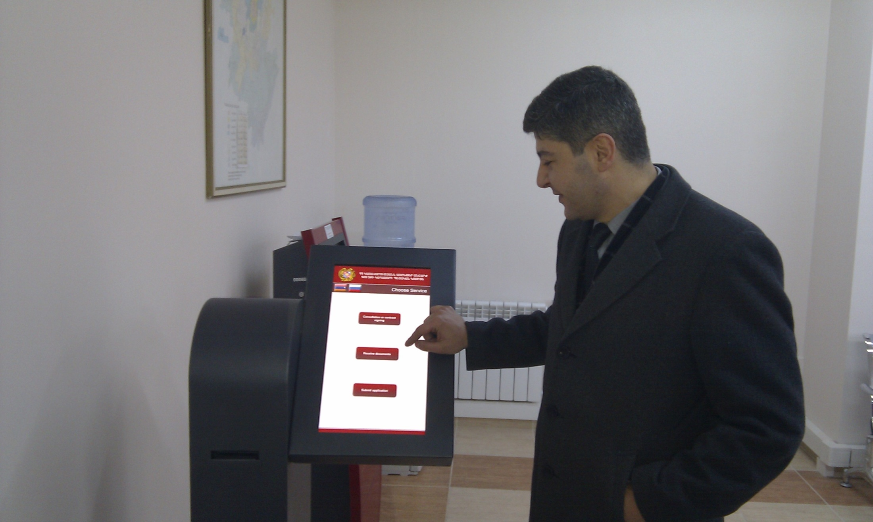
Draw a queue number and make your payment at an ATM

Slide 20
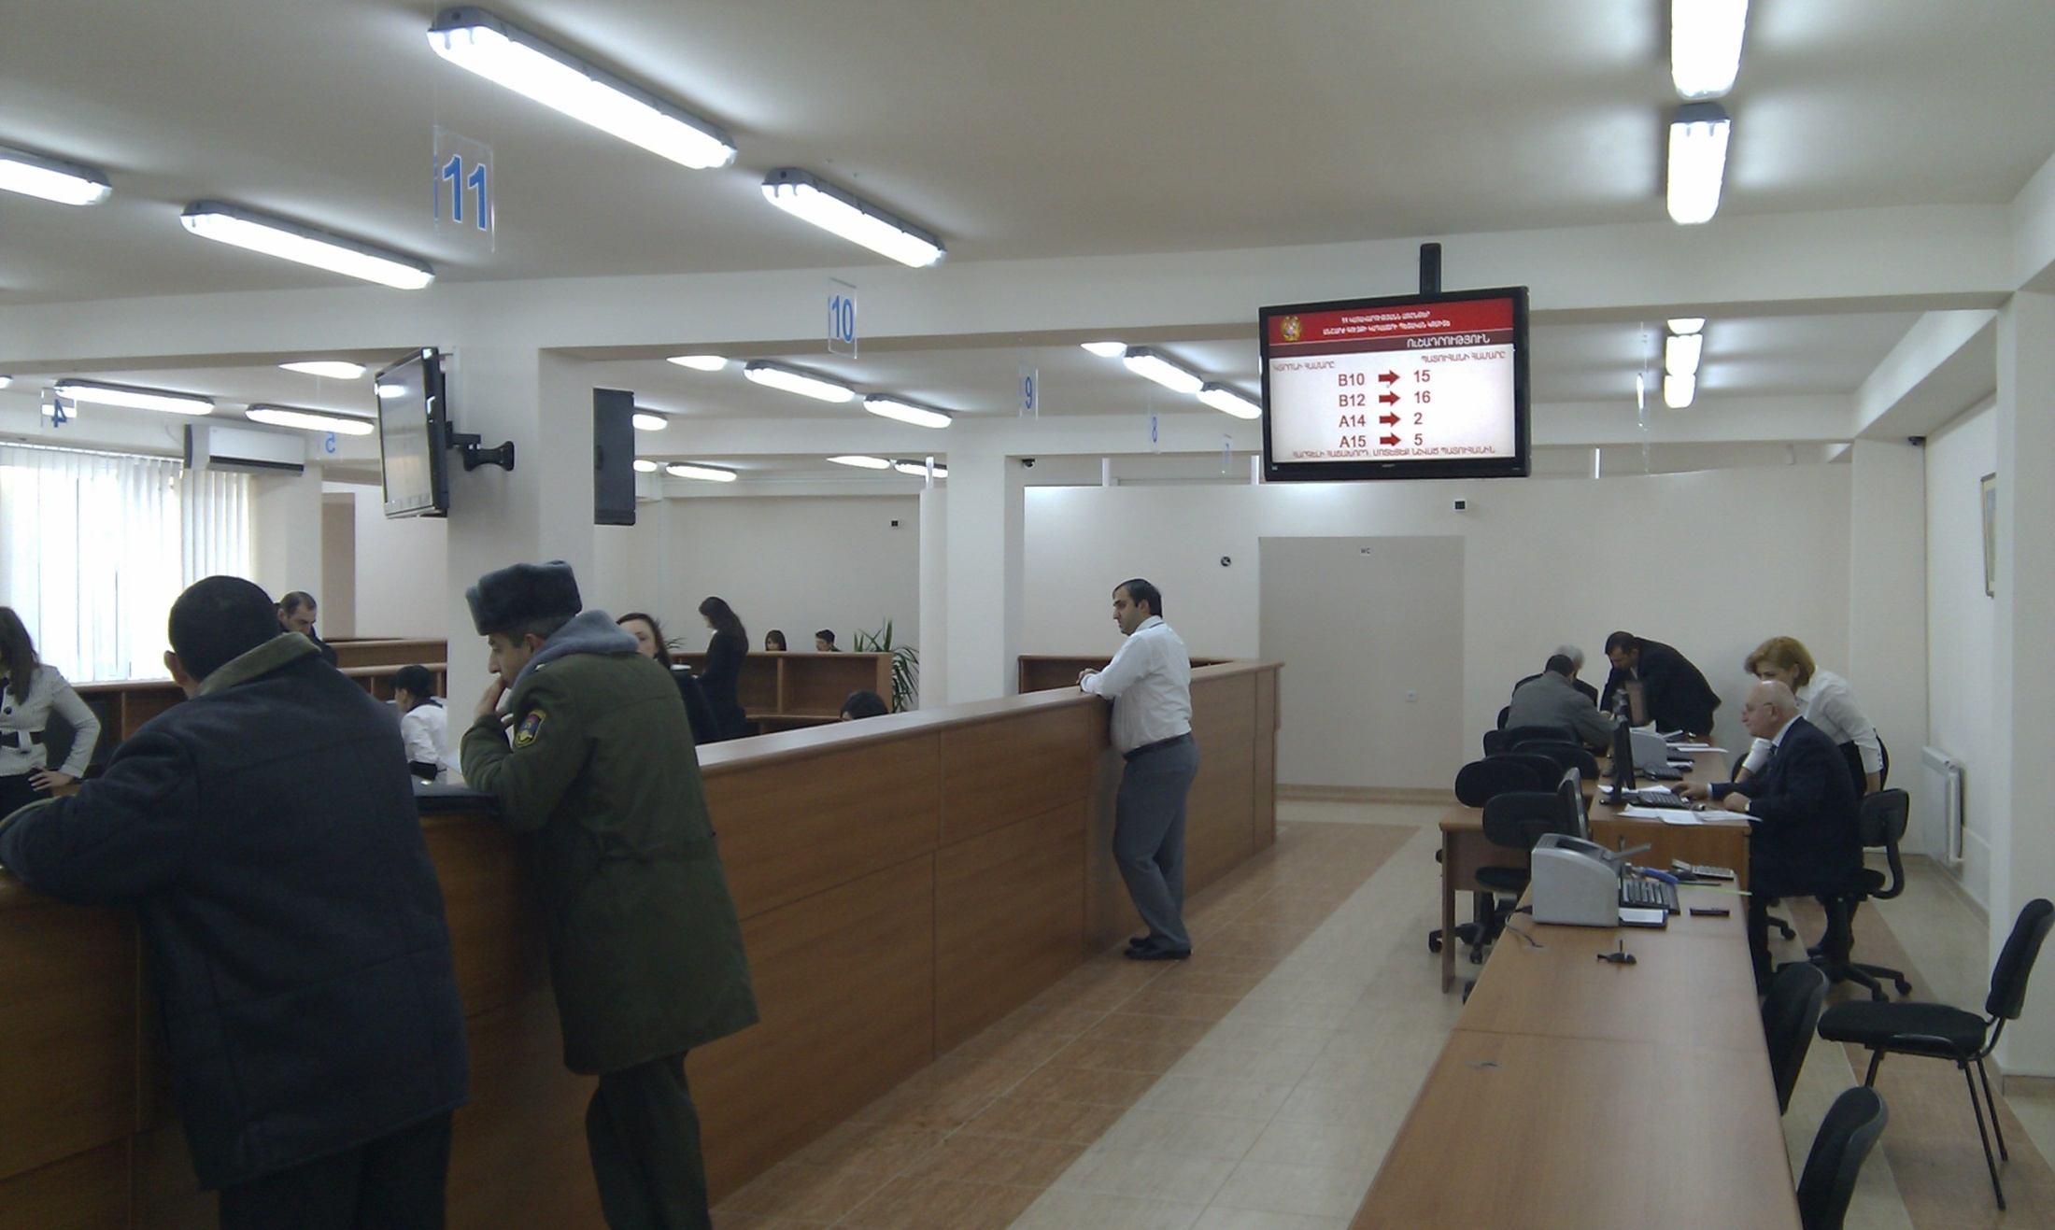
Watch for your number to come up

Slide 21
Deliver your documents

Slide 22
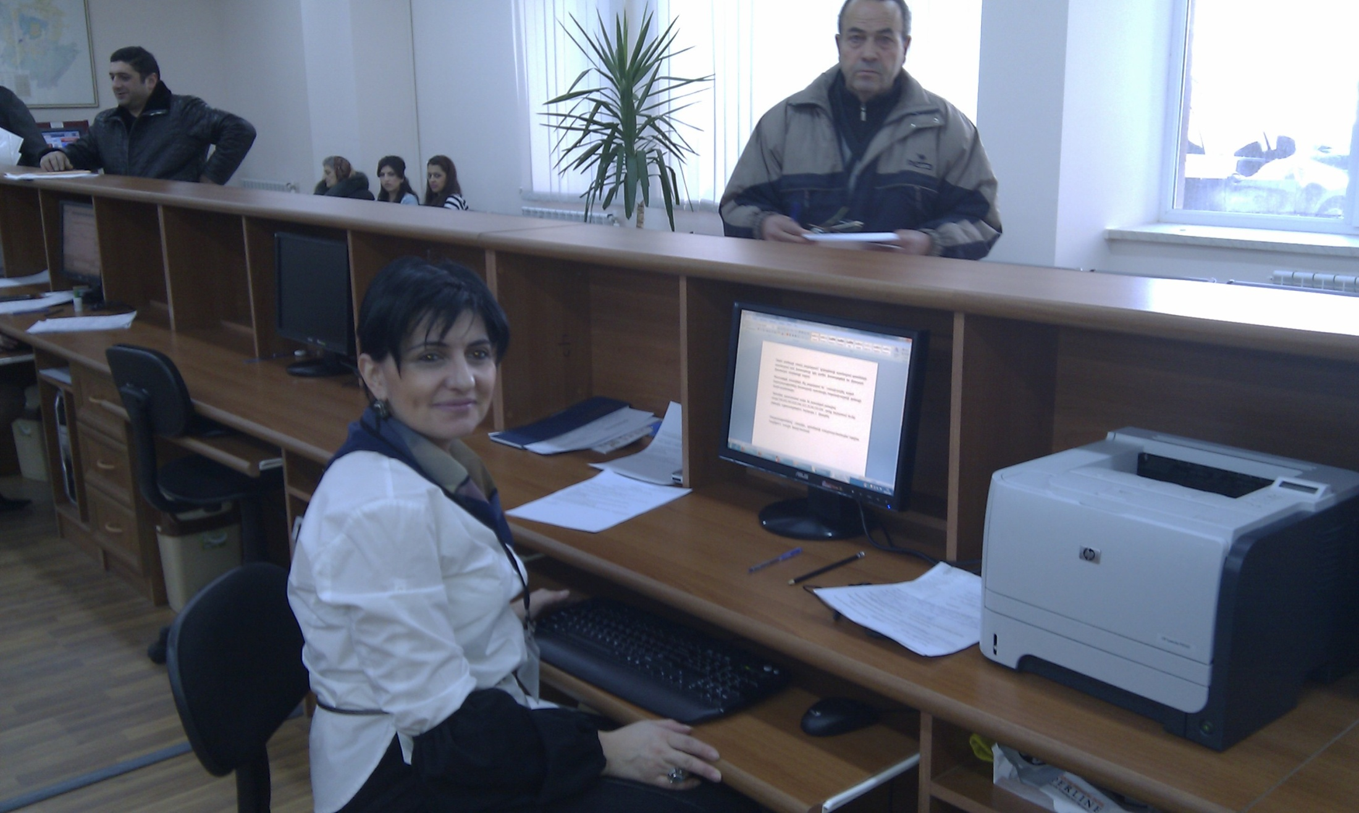
Watch the daybook being filed

Slide 23
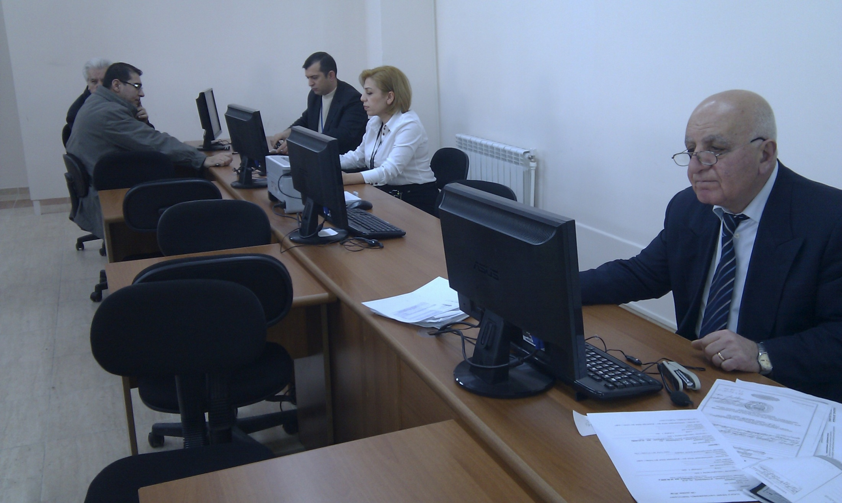
Meet a public notary/registrar if needed

Slide 24
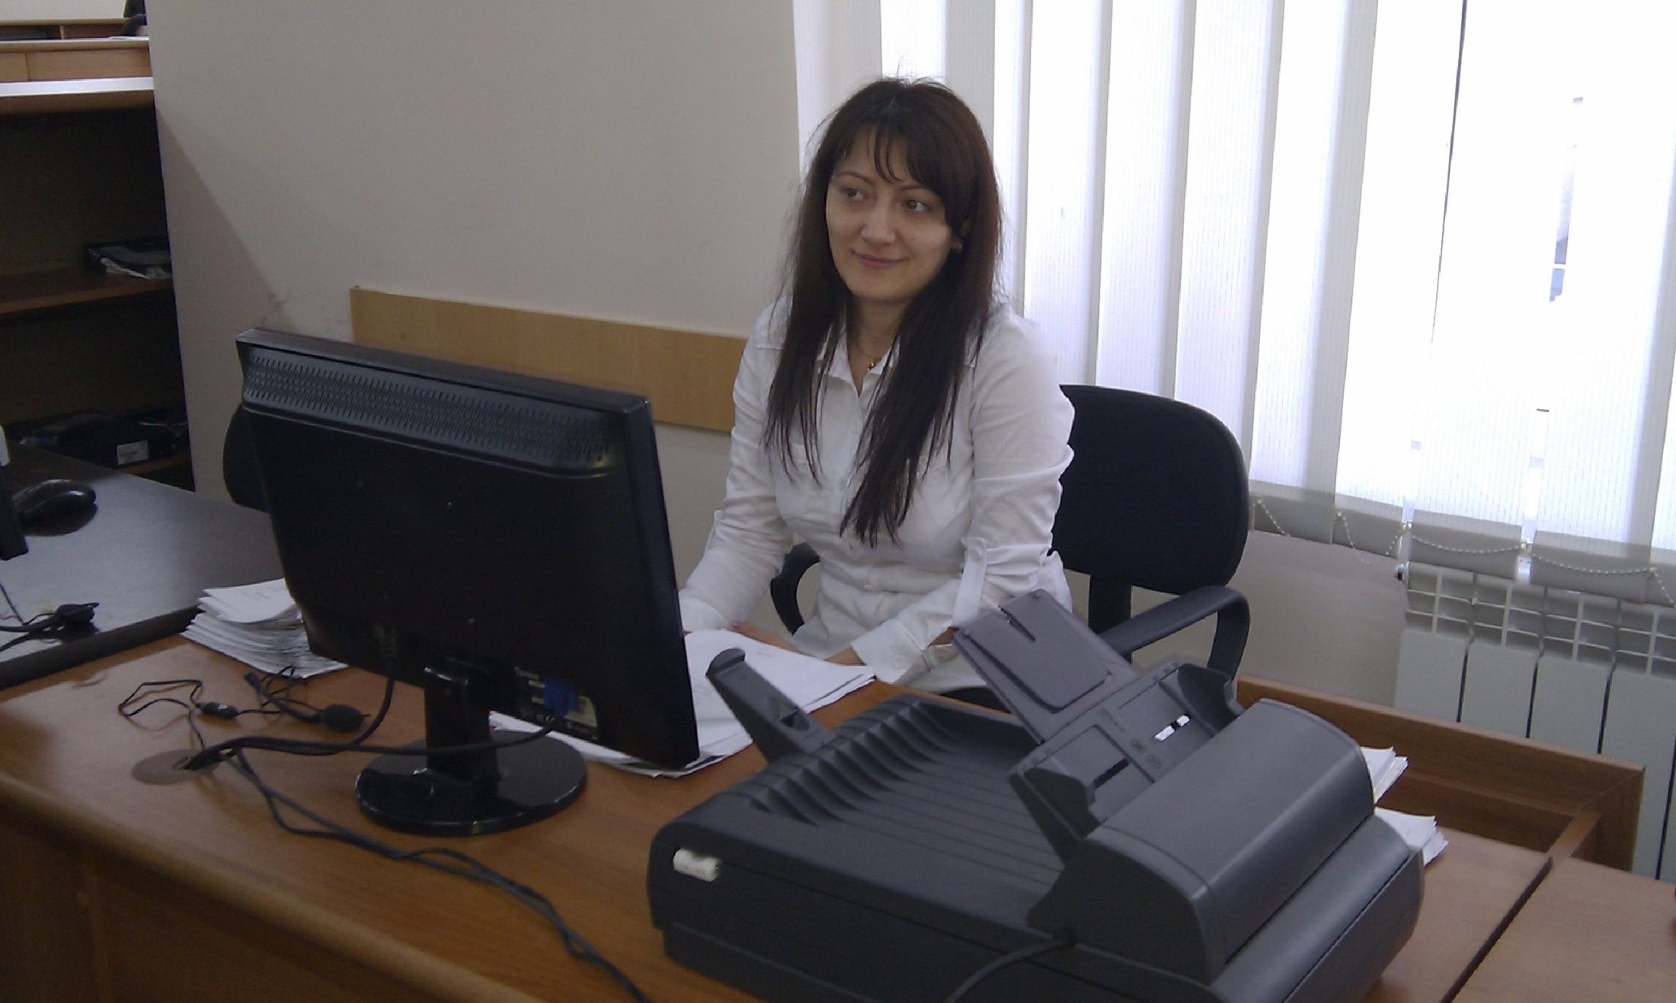
The documents are scanned

Slide 25
Scanned documents are transferred to the registration office for checking and registration

